Slide 1

Exploratory Data Analysis (EDA) on Bitcoin (BTC)
By: Eng/Ahmed NasrElDin

Slide 2

Introduction
Welcome to an exploration of the intersection of technology, data, finance, and Bitcoin
Get ready to dive deep into BTC's price movements and trading strategies using Python and Streamlit
Bitcoin, the pioneer of cryptocurrencies, is decentralized and operates on blockchain technology
It offers fast transactions, security, decentralization, and a capped supply of 21 million coins
Bitcoin's impact on finance, decentralization, and possibilities in cross-border payments are transformative

Slide 3

Case Study: Analyzing Bitcoin Price Trends and Trading Strategies
In this case study, we will explore the historical price data of Bitcoin (BTC) and analyze various trading strategies based on this data. Bitcoin is a digital cryptocurrency that has gained significant attention and investment in recent years. We will investigate its price movements, metrics, and evaluate different trading approaches.

Slide 4

Exploring the Data
Initial data loading and overview.
Summary statistics to understand the data.
Data visualization to visualize Bitcoin price trends over time.
Identifying key dates or events that coincide with price spikes or drops.

Slide 5
Exploring the Data
We use various libraries like Pandas, Statsmodels, Matplotlib, Plotly, and Seaborn for data analysis
Visualizing data helps identify trends, patterns, and insights
Key statistics like mean, standard deviation, min, max, and percentiles provide insights into Bitcoin's price data

Slide 6



Data Preprocessing
Handling missing data or outliers, if any.
Data normalization or scaling for analysis.
Resampling the data to different time intervals (e.g., daily, weekly, monthly) for further investigation.

Slide 7
Data Preprocessing
Converted timestamps, and resampled it to various time intervals. This allows us to examine Bitcoin's price and trading patterns over different time horizons.

Slide 8
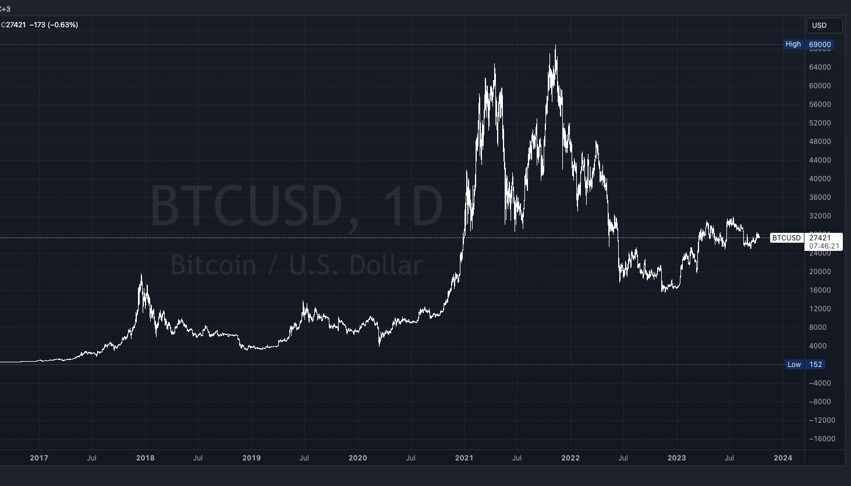
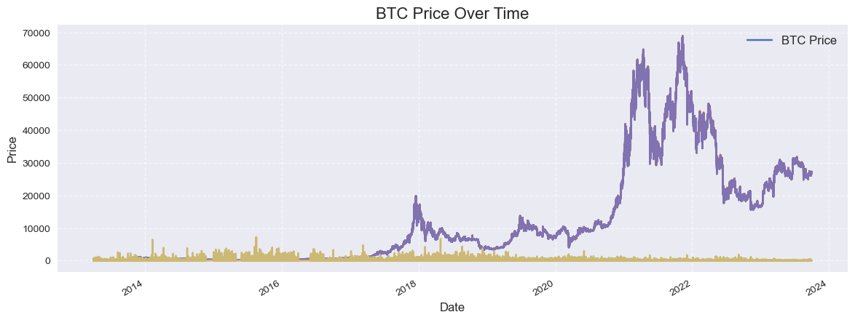

Slide 9
Trading Volume Analysis
Analyzing trading volume helps identify market interest and potential price movements
Visualizations and tables showcase the highest trading volume days
Data is resampled into various time intervals to reveal different insights
Calculations include percentage change and total traded values

Slide 10
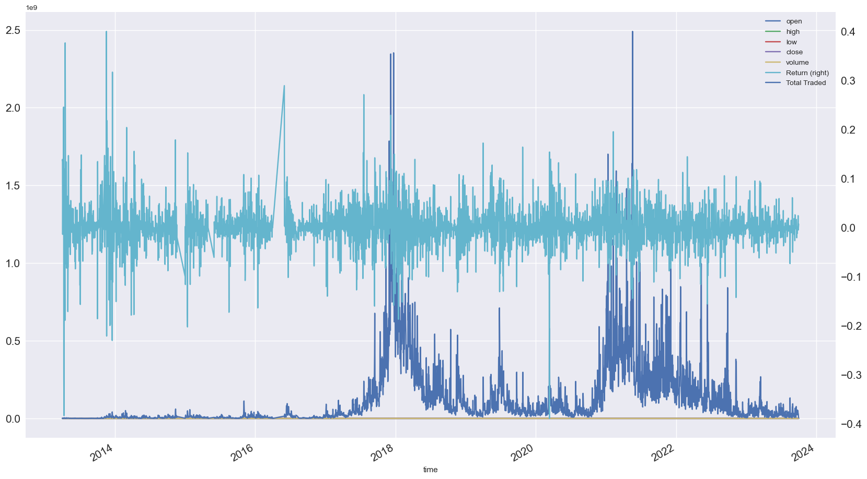

Slide 11
Return Metrics
Calculating daily returns to understand the volatility of Bitcoin prices.
Visualizing the distribution of returns using histograms and density plots.
Analyzing key return metrics such as mean return, standard deviation, and skewness.
Annualize statistics for long-term investors

Slide 12
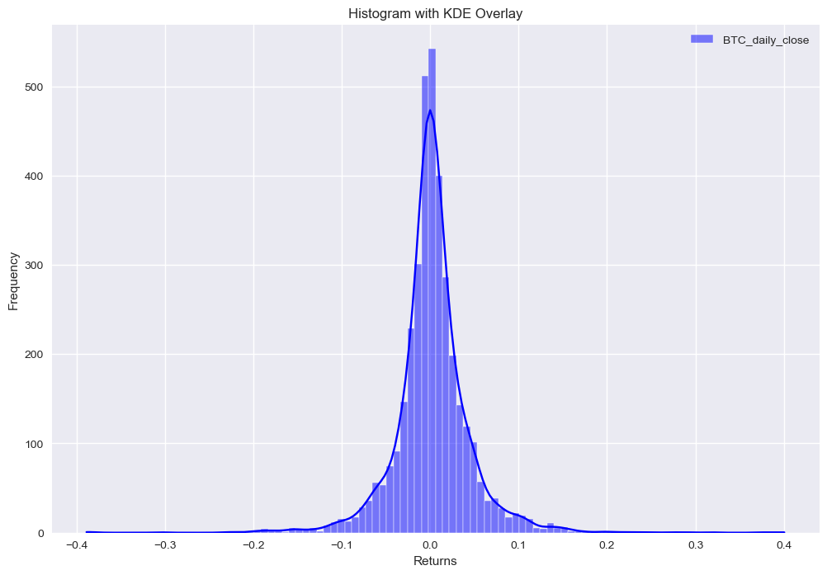
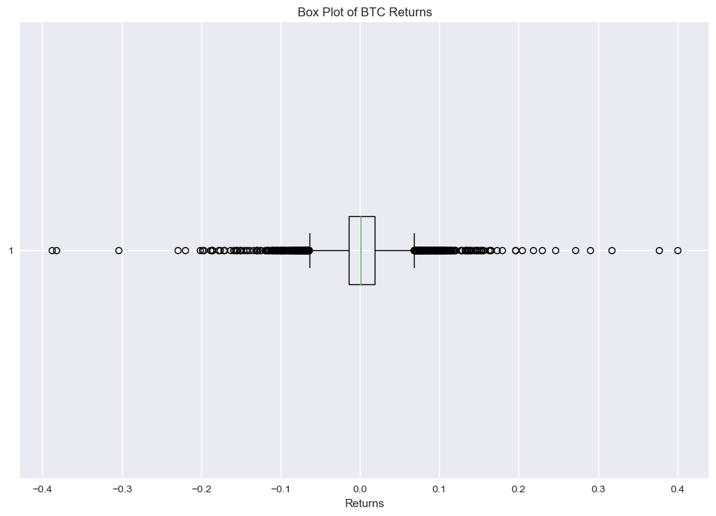

Slide 13
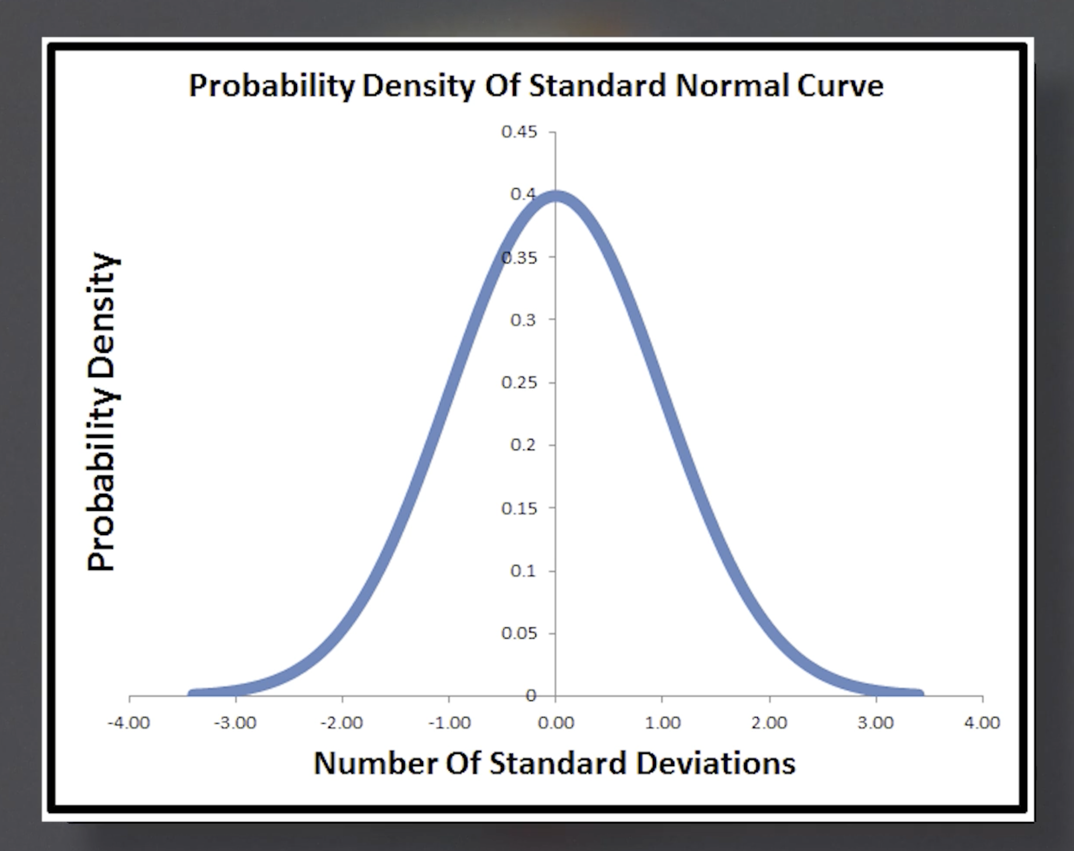
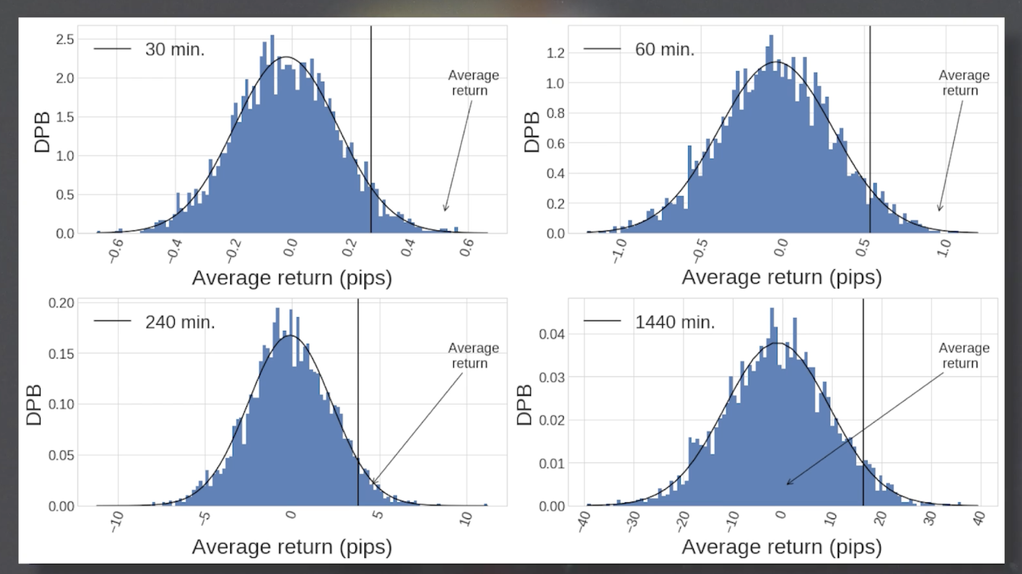
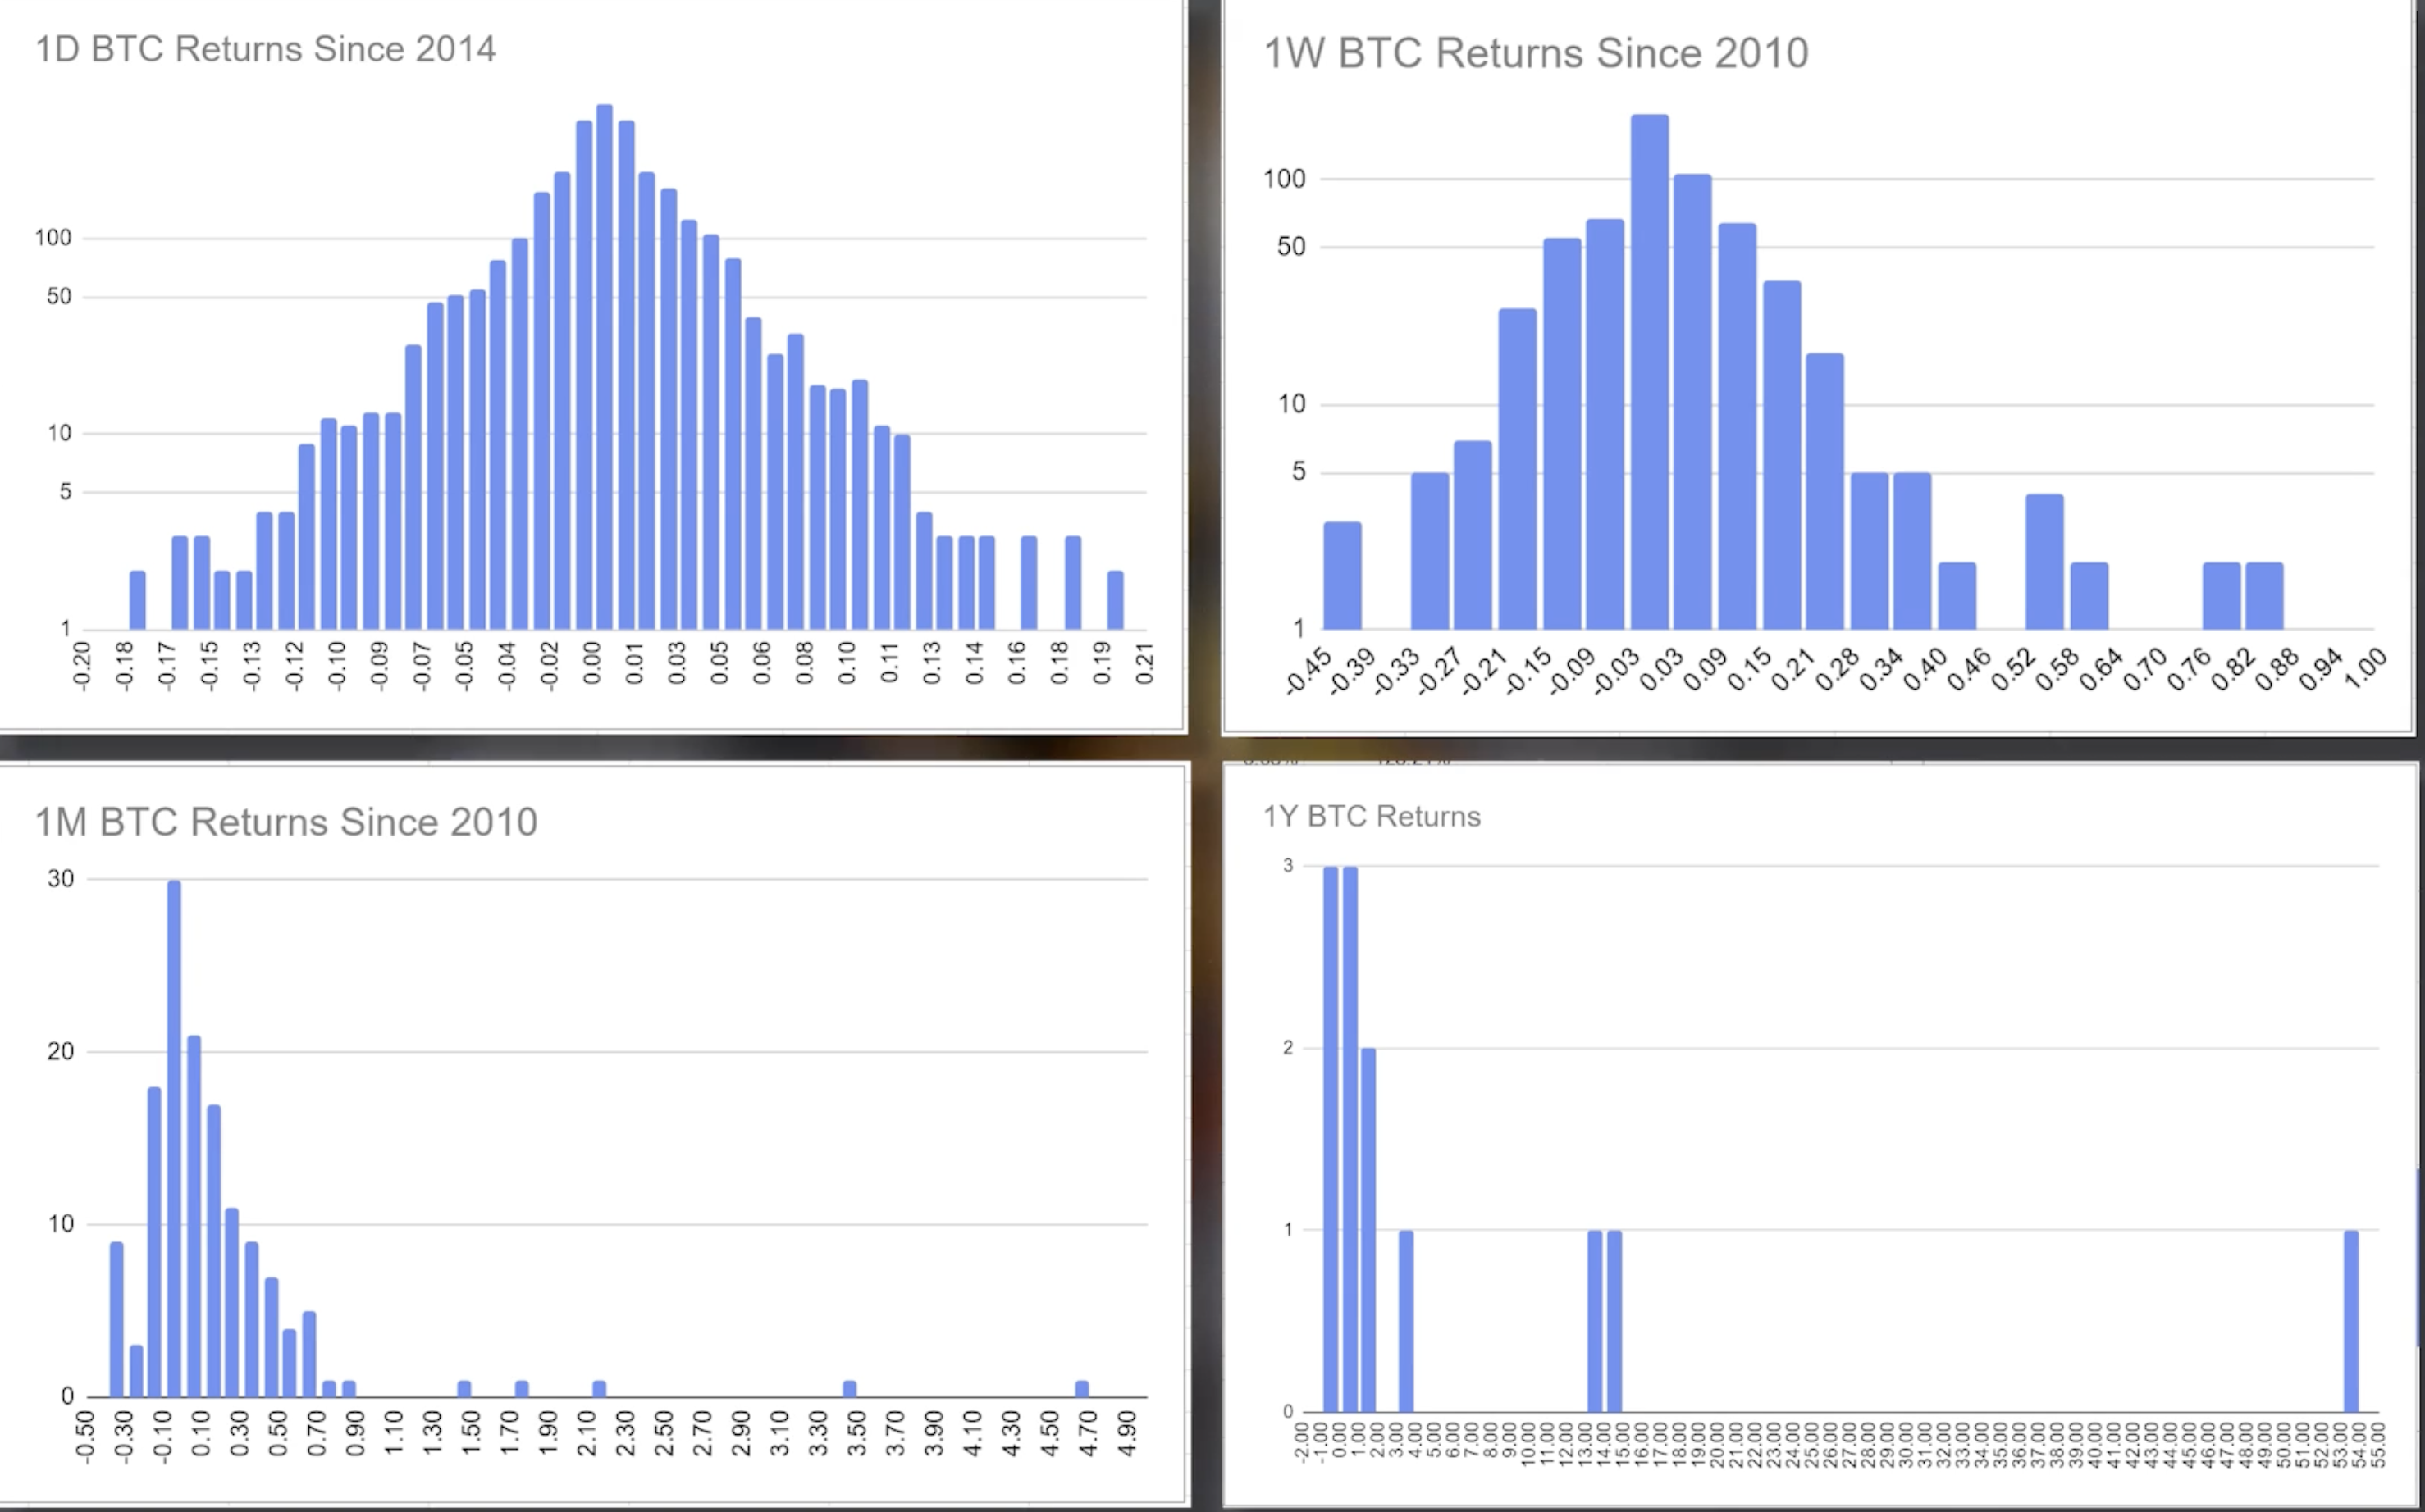

Slide 14
Customized Price Visualization
Customized plots help visualize Bitcoin price data
Dual axes show price changes' correlation with percentage returns

Slide 15
Box Plot Analysis
Box plots display price distribution, quartiles, and outliers
Valuable for understanding price distribution and volatility
Histograms with Kernel Density Estimate overlays show the distribution of daily returns
Essential for risk assessment and decision-making

Slide 16

Moving Averages
Using Simple Moving Averages (SMA) and Exponentially-weighted Moving Averages (EWMA) to identify trends.
Implementing SMA and EWMA crossover strategies for trading.
Comparing the performance of these strategies.

Slide 17
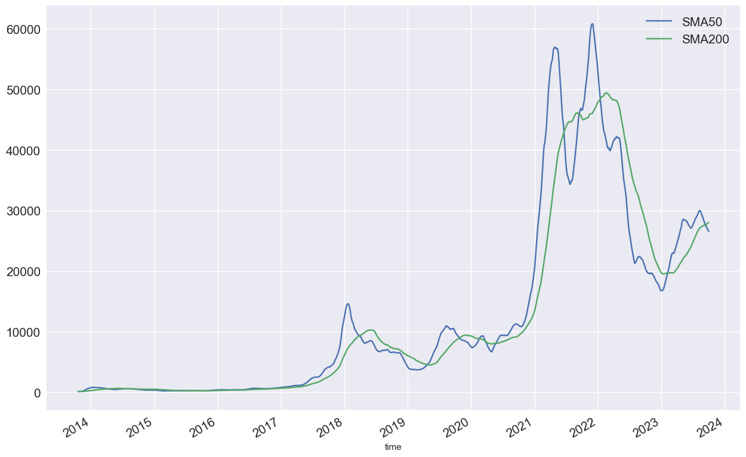
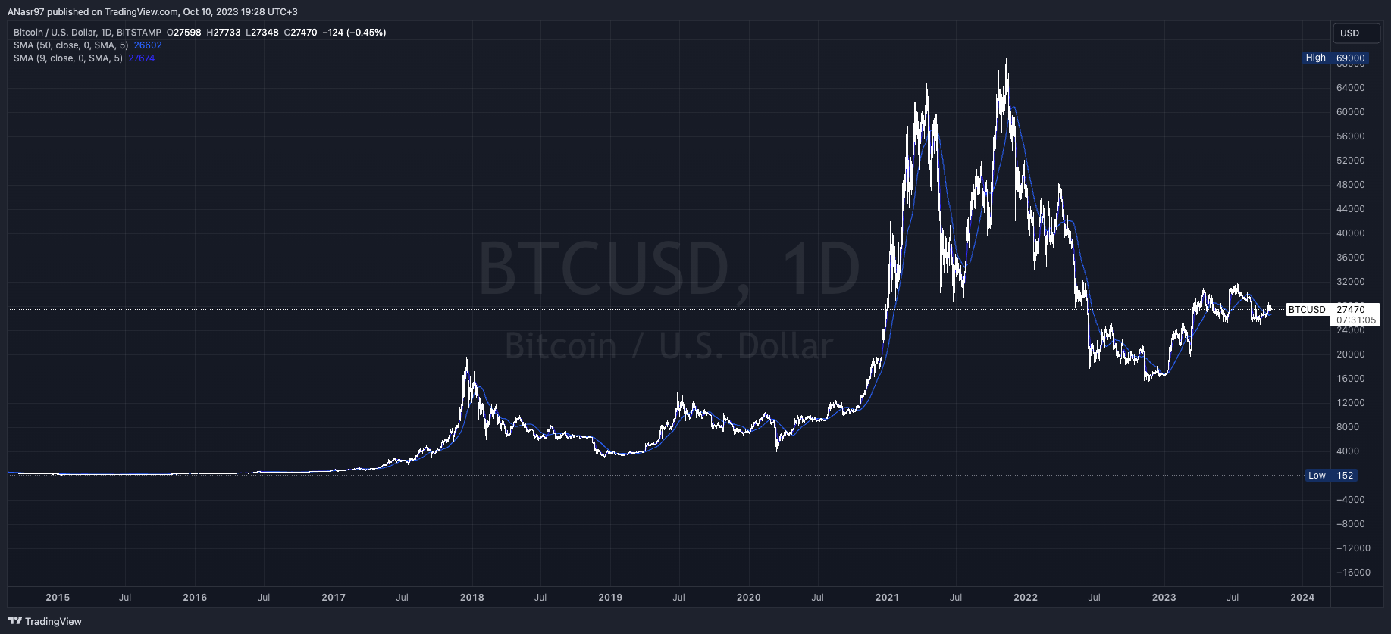
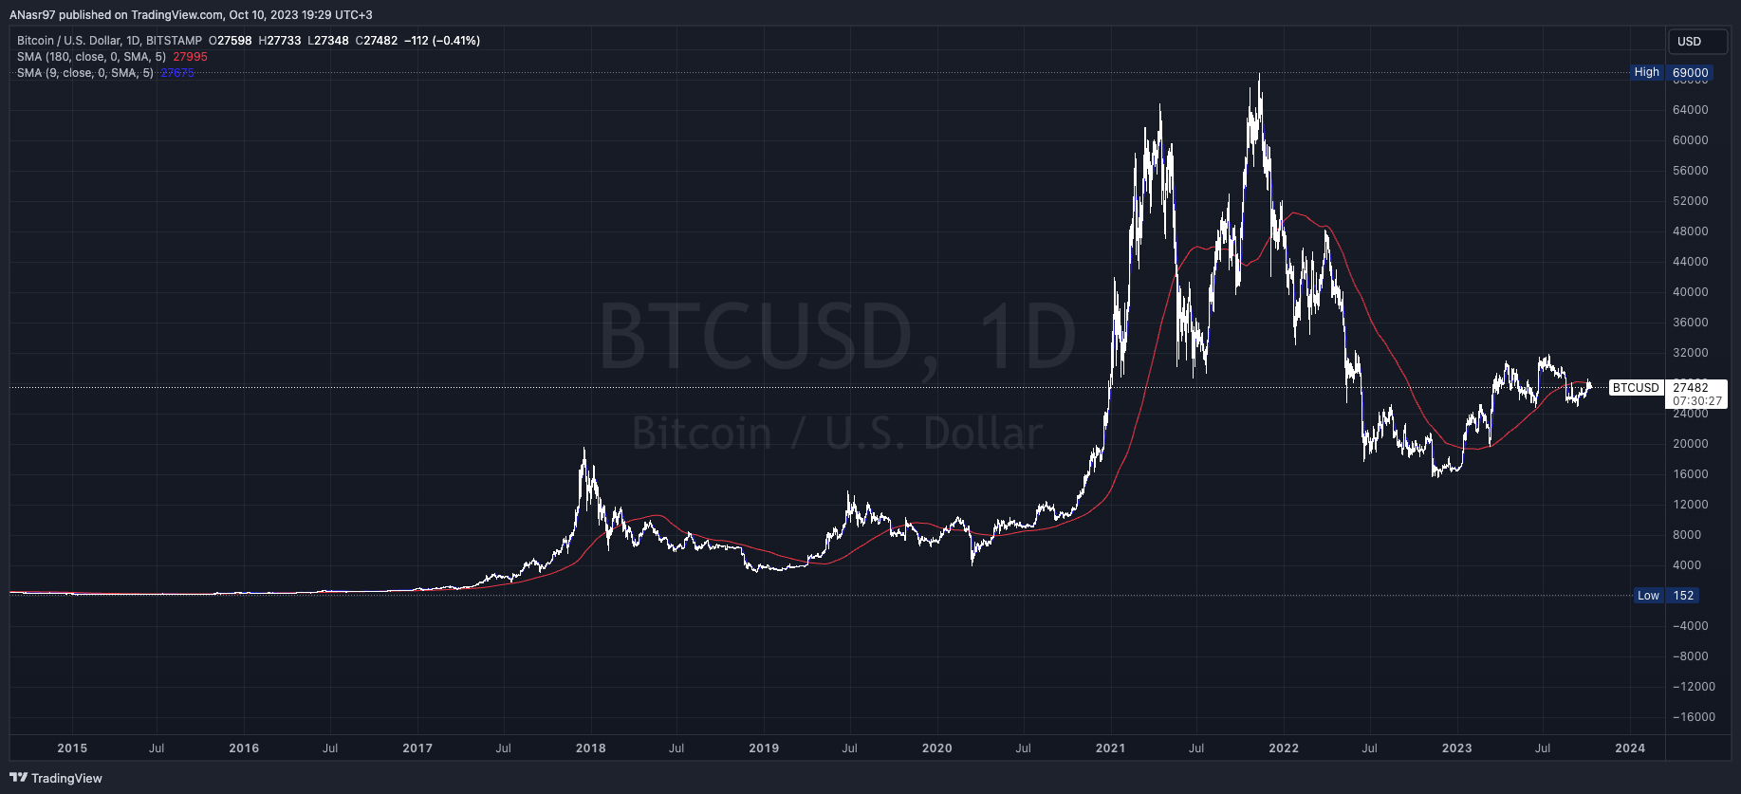

Slide 18
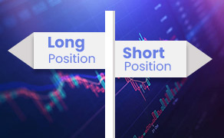

Trading Positions Strategy
Implementing a simple trading strategy based on daily returns.
Defining positions (long, short, or neutral) based on return thresholds.
Calculating cumulative returns for each strategy.

Slide 19
Time Series Analysis
Applying the Hodrick-Prescott (HP) filter to separate trends and cycles in the Bitcoin price.
Visualizing the trend and cyclical components.
Identifying periods of high volatility or unusual behavior.

Slide 20
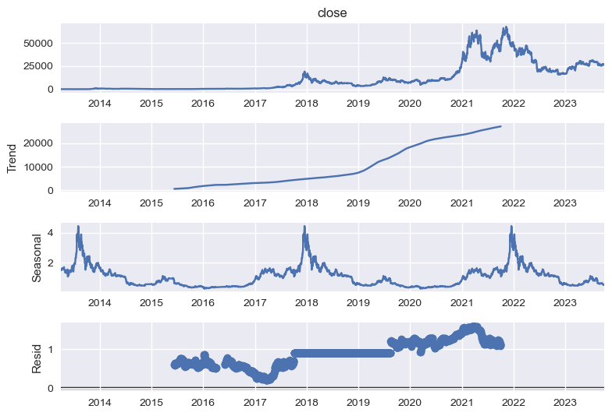

Slide 21
Seasonality and Stationarity
Detecting seasonality in Bitcoin price data and addressing it.
Conducting Augmented Dickey-Fuller tests to assess stationarity.
If needed, exploring more advanced models like Seasonal ARIMA for forecasting.

Slide 22
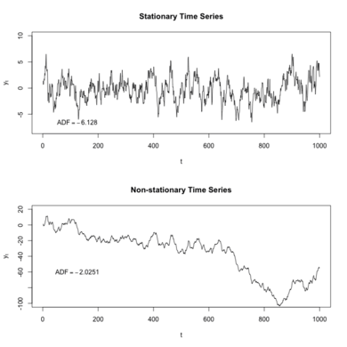

Slide 23
Dashboard Overview
Navigate through different sections of the dashboard to explore BTC data and strategies

Slide 24

Key Takeaways
Bitcoin prices are highly volatile, making it an attractive asset for trading.
Moving average strategies can help identify trends and inform trading decisions.
Understanding seasonality and stationarity is crucial for accurate price predictions.
Trading cryptocurrency involves risks, and strategies should be thoroughly tested and evaluated.

Slide 25

Conclusion and Insights
This case study showcases how data analysis and various trading strategies can be applied to historical Bitcoin price data. It provides valuable insights into the cryptocurrency market and demonstrates the importance of data-driven decision-making in trading.
Summarizing the key findings from the analysis.
Highlighting successful trading strategies and areas for improvement.
Providing insights into the behavior of Bitcoin prices and its potential implications.

